Slide 1
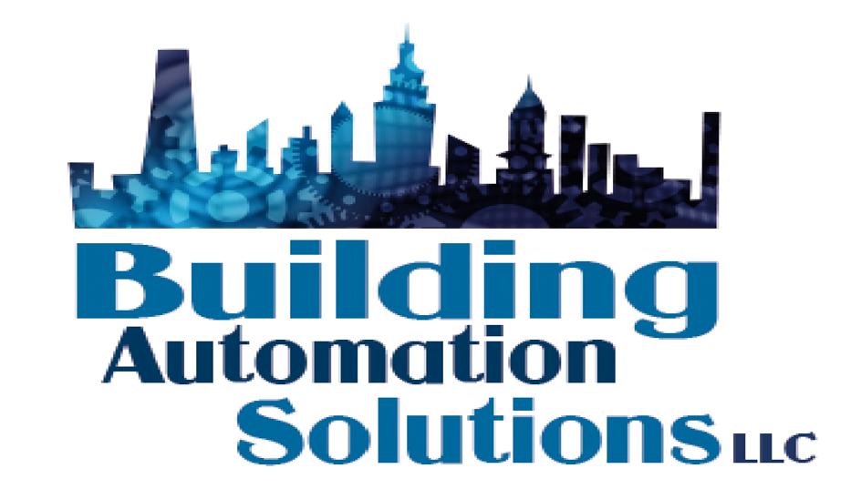
Building
Automation
Solutions LLC
Advanced Automation and Integration Solutions
17 Union Place, Hempstead, NY 11550
Office – (516) 232-2336
Email – Office@BASNewYork.com

Slide 2
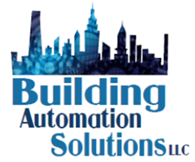
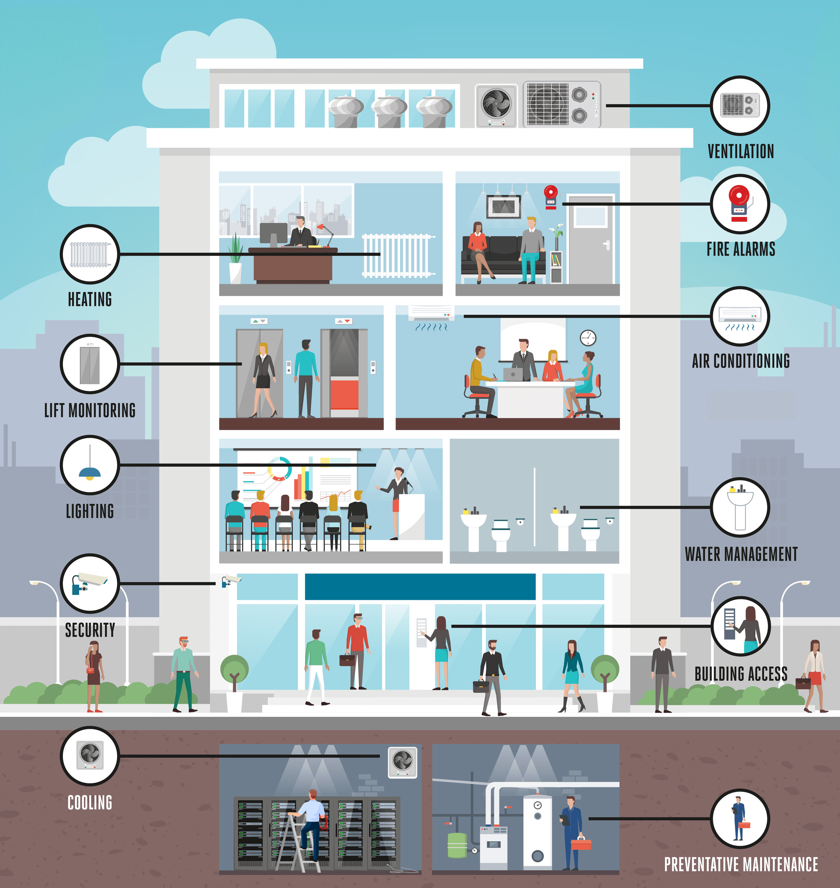
Building Automation Solutions, llc
About Us
Founded in 2016
Over 100 years combined automation and mechanical systems experience
Certified Honeywell Systems Integrator
Certified Tridium Systems Integrator
Certified Niagara Engineers
Certified FinStack Installer
Key Team Members
John Gil, Jr. - President
Kelly Reiser – VP of Sales
Serge Labudev – Director of Engineering
David Marmann – Systems Specialist
Richard Schwartz – Software Engineering
Private And Confidential

Slide 3
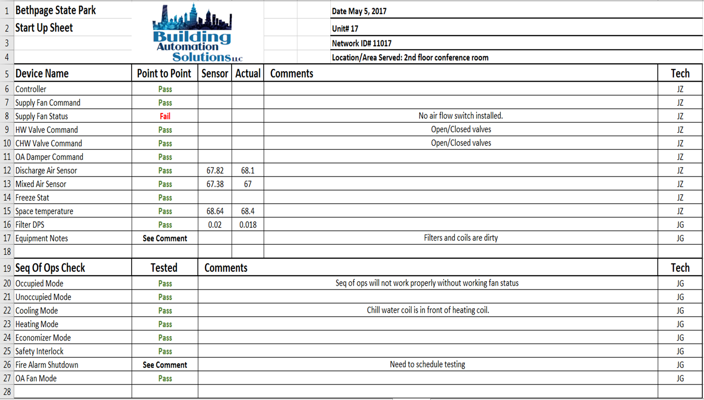
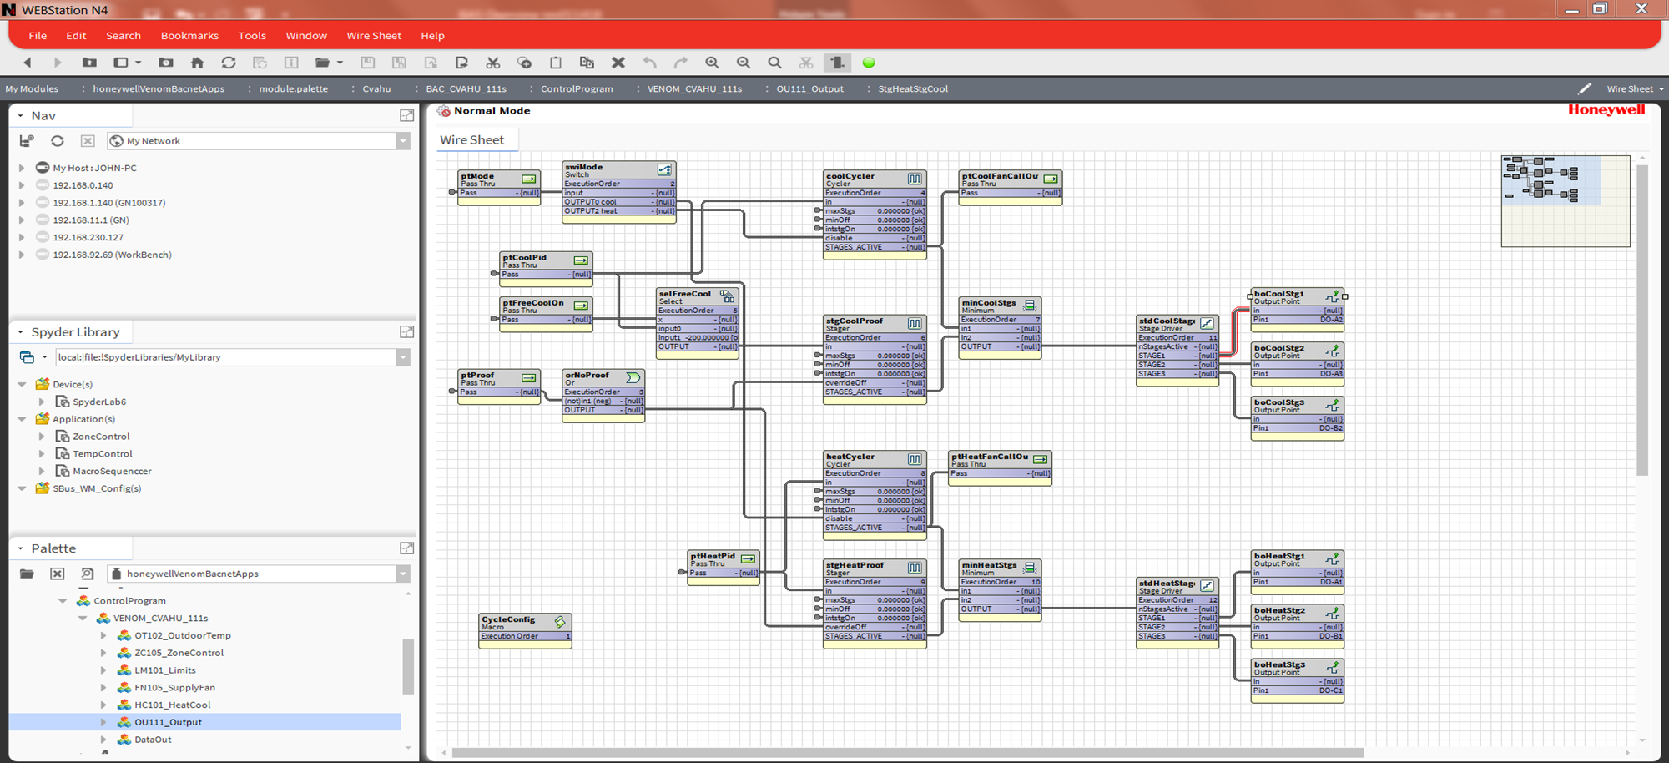
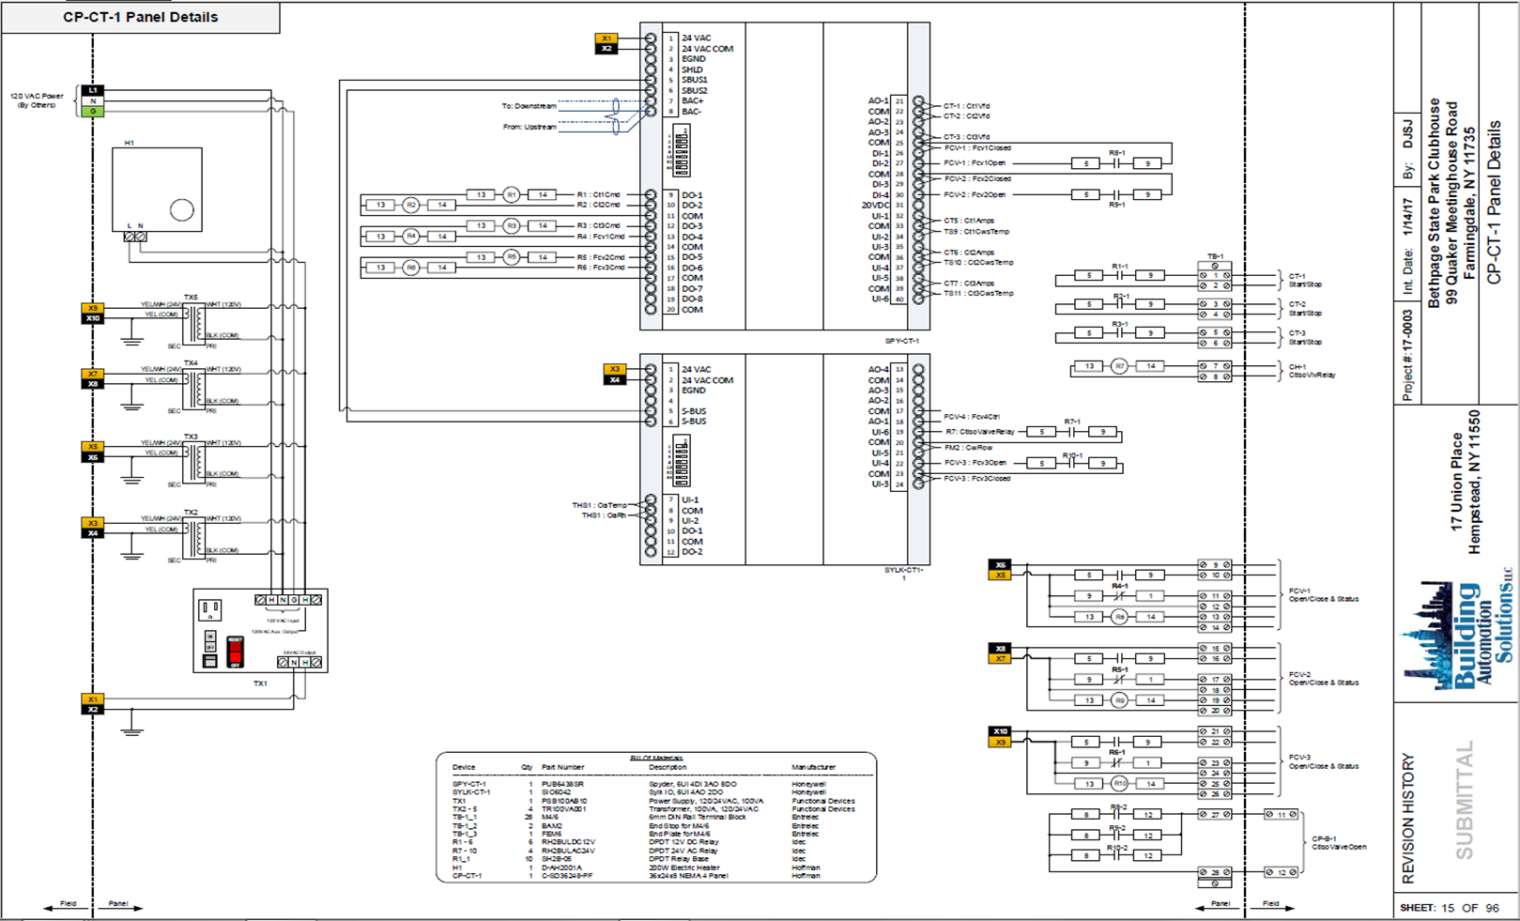
THE MISSION -
Gather the most experienced and knowledgeable team working with select clientele
Building Automation Solutions LLC (“BAS”) is focused on delivering exceptions service with a clear mission that supports the best interest of our client always being the driving force.
It is the mission of the BAS team to bring together the most experienced and knowledgeable controls team in the NY Market. Using our combined skills, we seek to deliver exceptional service while continually improving through the application of high-quality standards, continual process and personal improvement and an atmosphere committed to teamwork.
Keys to Success –
Well Defined Processes around all key functions
System Design – Design standards built to deliver your projects on time and within budget. BAS will work with your design engineers to ensure you have the latest technology to achieve the most reliable and energy efficient operations.
Construction Management – Project management tasks coupled with a well-trained team and the most open systems available.
Service Delivery – Well defined service delivery plan to ensure that scheduled service is delivered, and your system is maintained in top shape.
Private And Confidential

Slide 4
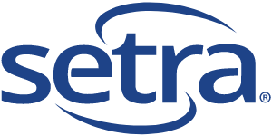
THE TECHNOLOGYS
The most advanced and open automation products
Private And Confidential

Slide 5
THE SERVICES -
Services designed to meet your building management system needs
Building Automation Solutions LLC (“BAS”) is a certified expert in providing complete building management systems offering comprehensive solutions for new or existing systems to best serve a client’s operations and budget.
Planned and Tracked Service Delivery
Comprehensive Upgrade Design
New and Existing System Integration
Open Protocol Migrations
Secure Local and Cloud Based Network Architecture Design
Client owns hardware, software and software tools breaking vendor lock.
Automation
Integration
Planned Service
Master BMS
Planning
Private And Confidential

Slide 6
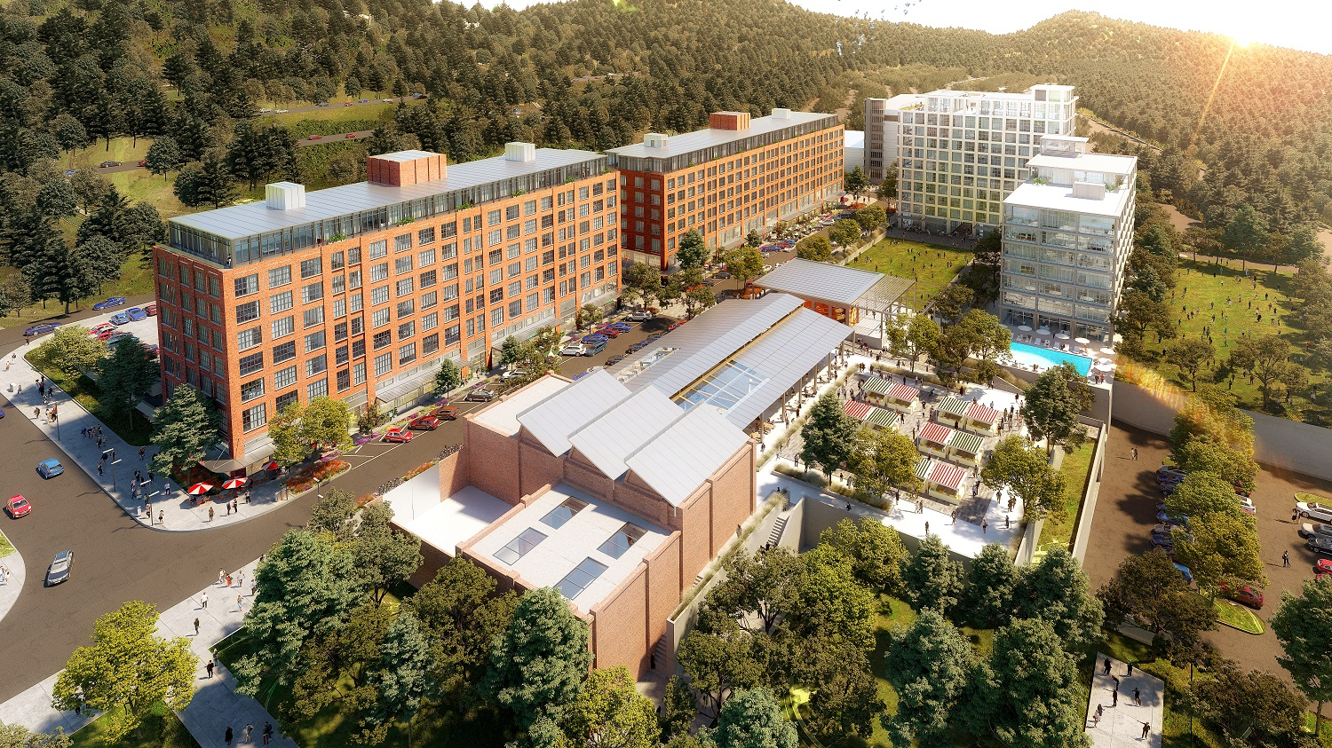
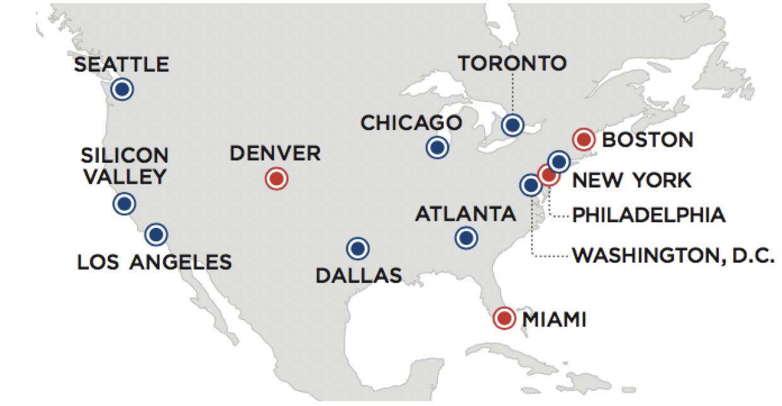
THE VERTICALS -
Leveraging decades of experience to ensure your projects and systems are robust and secure
Building Automation Solutions LLC (“BAS”) brings decades of experience in the building automation space but has specialized knowledge that is applicable to specific verticals. .
Hospitals and Healthcare - Hospitals have unique requirements and BASNY has the experience and skills to cover them all from room pressurization in operating rooms to hospital construction protocols. We have decades of experience working with major hospital and healthcare providers.
Data Centers - Critical environments where monitoring of temperature, humidity and power are a central focus of BAS. We work with some of the largest Data Center companies globally to deliver a streamlines solutions normalizing all data centers into a manageable portfolio.
Commercial Office Buildings – Commercial office buildings have been and will continue to be a key to our success. The BAS team has worked in many of the premier buildings throughout the tristate area and we understand the needs of building management and tenants.
Large Portfolios – Taking the next step to transform your infrastructure from individual buildings to a managed portfolio is a big step. BAS brings the expertise to seamlessly connect and manage your entire portfolio
Hospital and
Healthcare
Commercial
Office
Large
Portfolio
Data Centers
Private And Confidential

Slide 7
The Challenge
Upgrading and Integrating legacy control systems from different manufacturers across your portfolio
Sales & marketing
Finance
Engineering/Operations
Customer Support
Corporate Social Responsibility
Differentiator
Brand positioning
Reduction in operational cost
Higher profit
Data mining & facts-based decision making
Proactive and efficient Operations
Satisfied users
Higher retention
Reductions in energy consumption
Data driven CSR agenda
Regression engine
Facility Operations Center
Measurement &
verification
Predictive modeling
Analytics engine
Energy
analysis
Open integration platform
Data mining
Carbon footprint
analysis
Continuous
commissioning
Fault detection &
diagnostics
Integration framework
IP Based Tridium Interoperability Layer
NIUs – Obix, LonWorks, BACnet, OPC, MODBUS, EIB, SNMP, M-Bus protocols
Tridium Jace – LonWorks, BACnet, OPC, MODBUS, SNMP. (>100 protocols)
Building 1 –
Tridium
Building 1 –
Legacy
Honeywell
Building 1 -
Legacy
Johnson
Building 2 –
Andover
Building 2 –
BACnet
Building 3 –
Trane
Building 3 –
Distech

Slide 8
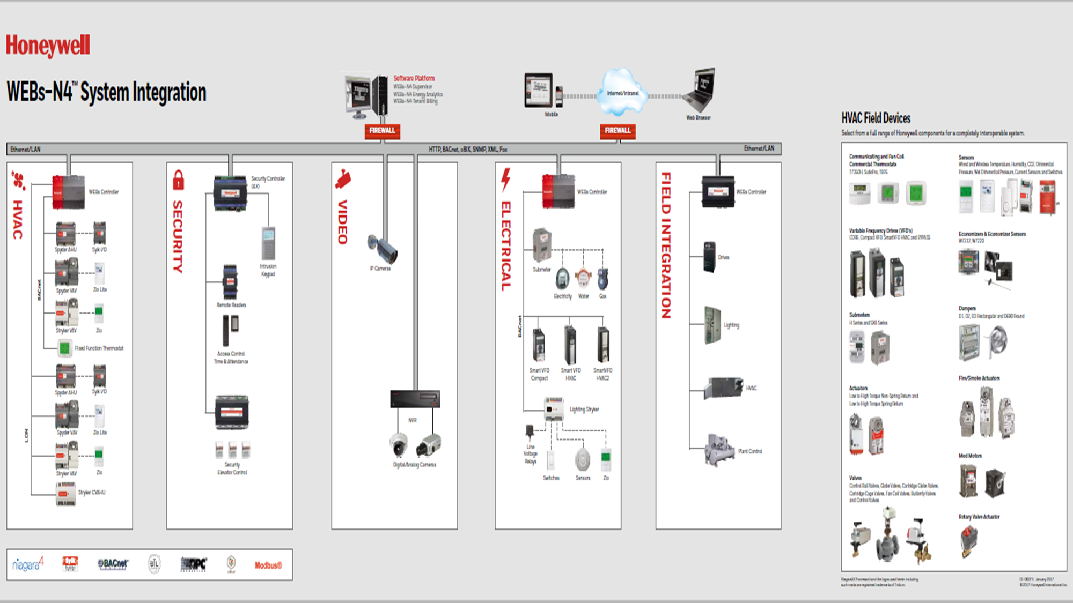
Portfolio Solution
The Honeywell N4 System

Slide 9
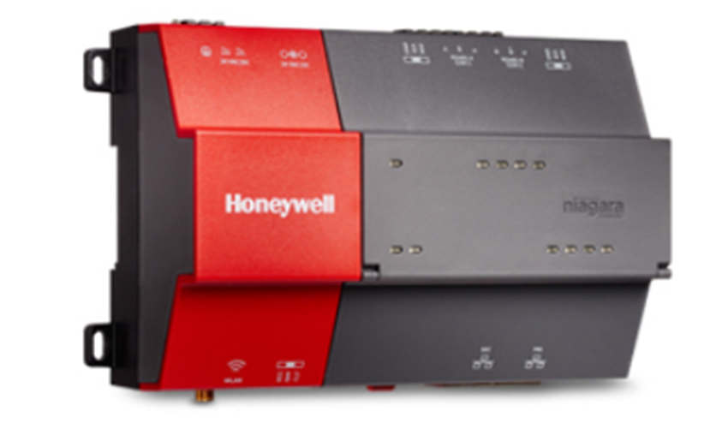
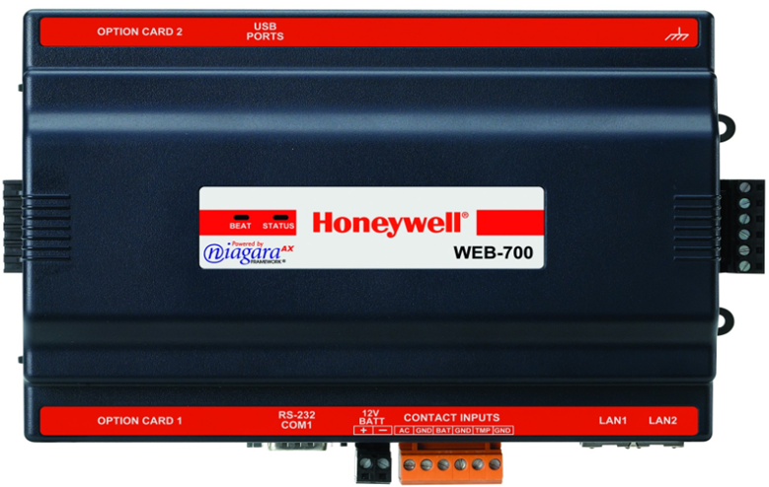
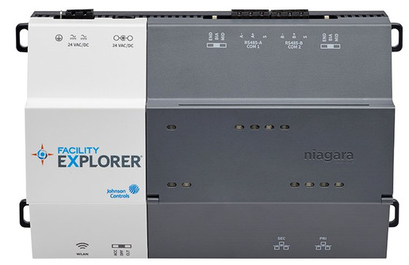
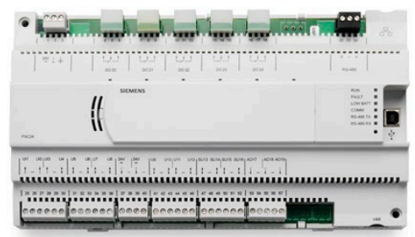
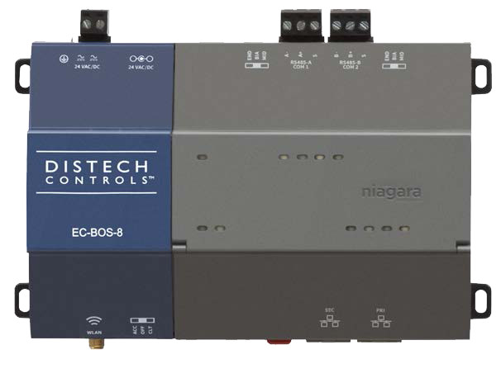
Tridium N4 – Niagara
The leader in open protocol integration for over 15 years!
Acquired by Honeywell
But used by all major controls manufacturers!
Distech
Johnson Controls
Siemens

Slide 10
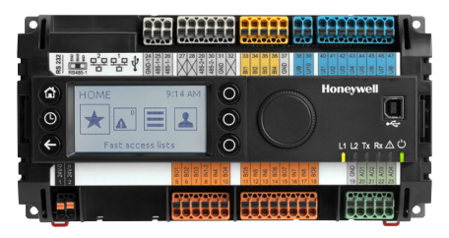
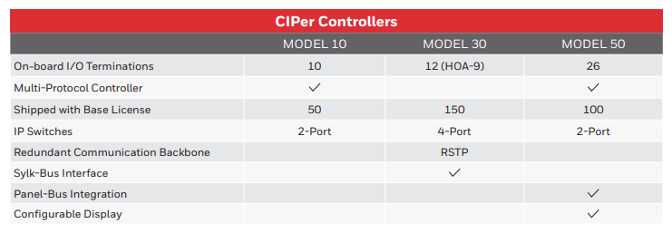
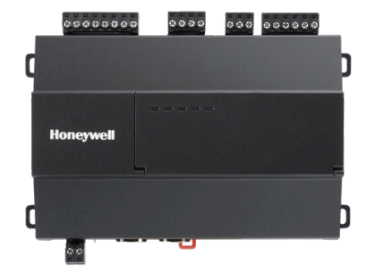
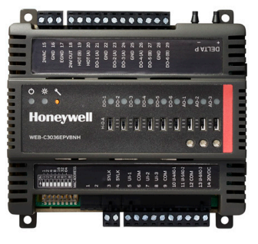
Honeywell CIPer
Web-Based Tridium N4 programmable flexible plant controllers
Open Protocol
Sold and supported by multiple contractors
NOT a branch only product
Web Support Built in
Latest Niagara N4
Fully programmable
Fast
Flexible
Modular

Slide 11
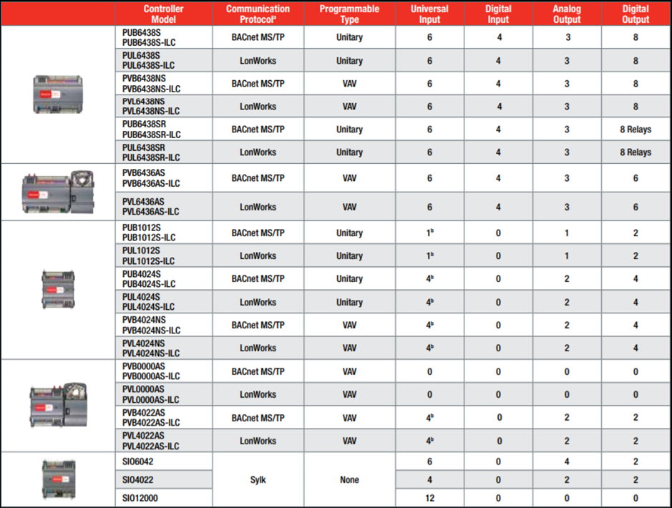
Honeywell Spyder
A complete line of robust, fully programmable application control devices
Universal Inputs
Flexible Outputs
Open Protocol
Sold and supported by multiple contractors
NOT a branch only product
Chillers
Boilers
RTU’s
VAV’s
Etc.

Slide 12
THANK YOU

